Slide 1
Monday March 2, 2020 8th Grade ELA
The Giver
Quick Write #7
Check Chapter 6 and Read Chapter 7
Booklet Pages 14-15

Slide 2
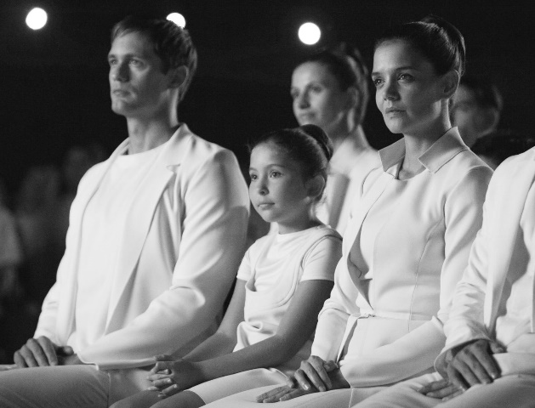
Tuesday March 3, 2020 8th Grade ELA
The Giver
Quiz – Chapters 1-6
Booklet Pages 16-17
Read Chapter 8 and Complete Discussion Questions

Slide 3
Wednesday March 4, 2020 8th Grade ELA
The Giver
Quick Write #8
Check Chapter 8 Discussion Questions
Booklet Pages 16-17

Slide 4
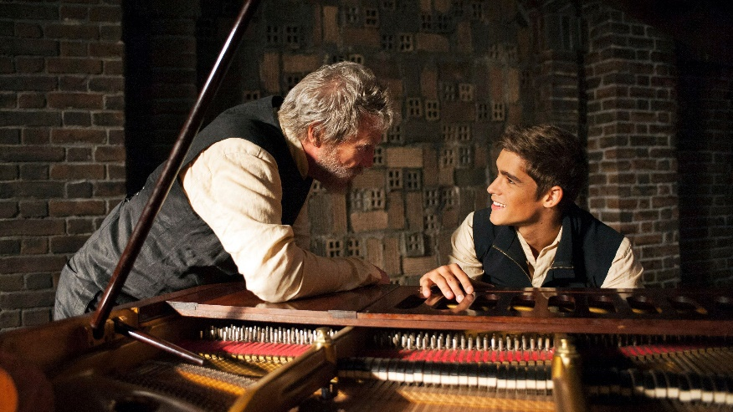
Thursday March 5, 2020 8th Grade ELA
NWEA Testing

Slide 5
Friday March 6, 2020 8th Grade ELA
NWEA Testing

