Slide 1
Monday March 2, 2020 7th Grade ELA
Group Reading – Prediction Pages
Text Message Inferences
Figurative Language Review

Slide 2
Tuesday March 3, 2020 7th Grade ELA
Group Reading Prediction Pages
Poem Inference Guide
Inferences and Supporting Evidence
Figurative Language Review
Figurative Language Quiz Tomorrow

Slide 3
Wednesday March 4, 2020 7th Grade ELA
Group Reading - Vocabulary
Inferences In Poetry
Figurative Language Quiz
Journal Writing

Slide 4
Thursday March 5, 2020 7th Grade ELA
NWEA Testing

Slide 5
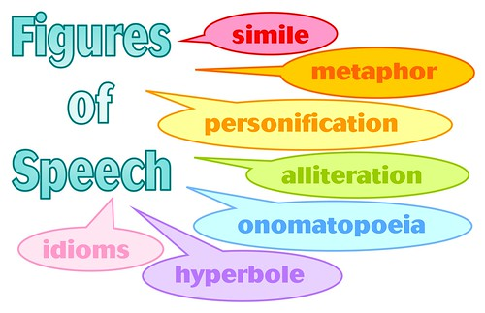
Friday March 6, 2020 7th Grade ELA
Group Reading - Vocabulary
Inferences – Solve the Mystery
Figurative Language Practice
Journal Writing

