Slide 1
Monday February 24, 2020 8th Grade ELA
The Giver
Lois Lowry Article and Questions
Chapter 1-3 Review Questions - Booklet

Slide 2
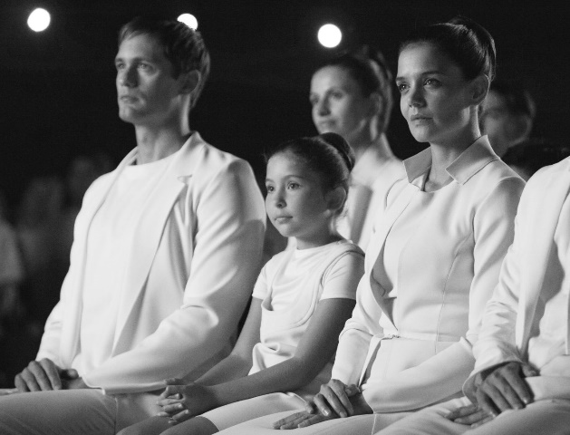
Tuesday February 25, 2020 8th Grade ELA
The Giver
Finish Chapter 1-3 Review Questions
Read Chapter 4

Slide 3
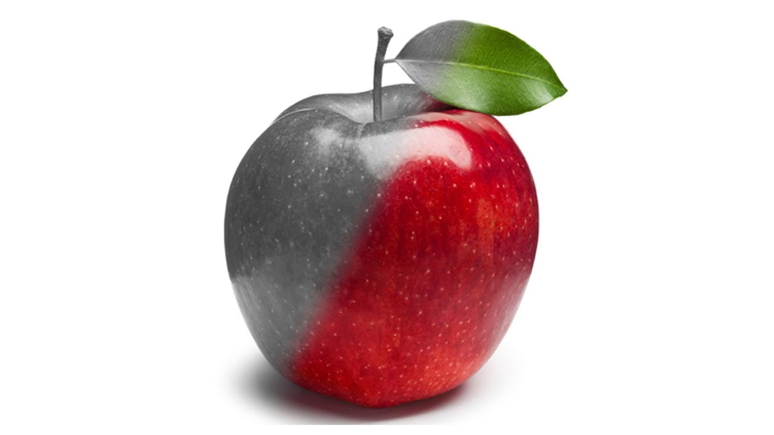
Wednesday February 26, 2020 8th Grade ELA
The Giver
Complete Chapter 4 Discussion Questions and Booklet Questions

Slide 4
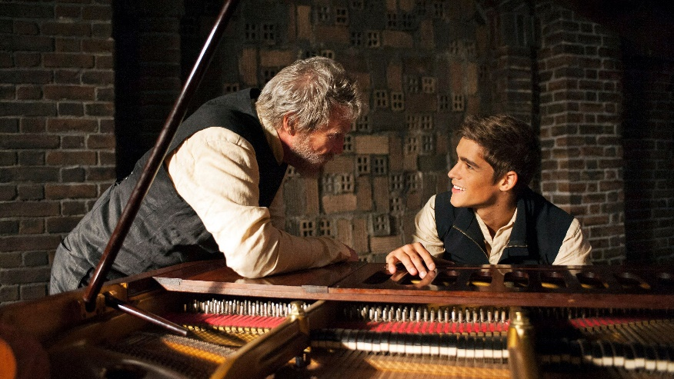
Thursday February 27, 2020 8th Grade ELA
The Giver
Writing Prompt #5
Read Chapter 5
Booklet and Discussion Questions

Slide 5
Friday February 28, 2020 8th Grade ELA
The Giver
Quiz
Check Chapter 5 Work
Read Chapter 6

