Slide 1
Monday February 24, 2020 7th Grade ELA
IDR – New Task Sheet
Golpe de Estado – Read Aloud
Argument Writing Practice
Figurative Language
Personification

Slide 2
Tuesday February 25, 2020 7th Grade ELA
IDR – Task Sheet
Golpe de Estado
Figurative Language
Journal Writing

Slide 3
Wednesday February 26, 2020 7th Grade ELA
IDR – Task Sheet
Check Golpe de Estado Discussion Questions
Inferences
Figurative Language Packet
Argument Writing Practice

Slide 4
Thursday February 27, 2020 7th Grade ELA
IDR – Task Sheet
Inferences
Figurative Language Quiz
Journal Writing

Slide 5
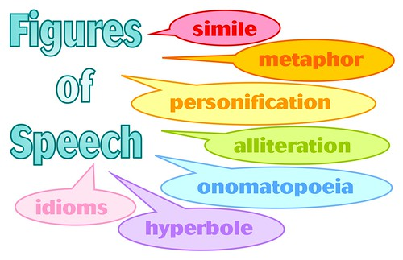
Friday February 28, 2020 7th Grade ELA
IDR – Task Sheet
Inferences
Figurative Language Practice
Argument Writing Practice

