Slide 1
Monday February 10, 2020 8th Grade ELA
The Giver
Writing Prompt – Perfection
Anticipatory Guide
Vocabulary 1
Chapter 1 and Discussion Questions

Slide 2
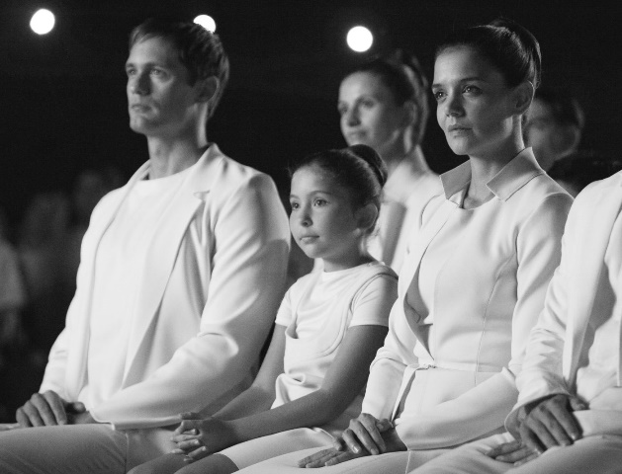
Tuesday February 11, 2020 8th Grade ELA
The Giver
Check Chapter 1
Read Chapter 2 and Discussion Questions
Writing Prompt #2 - Adults
Vocabulary 2

Slide 3
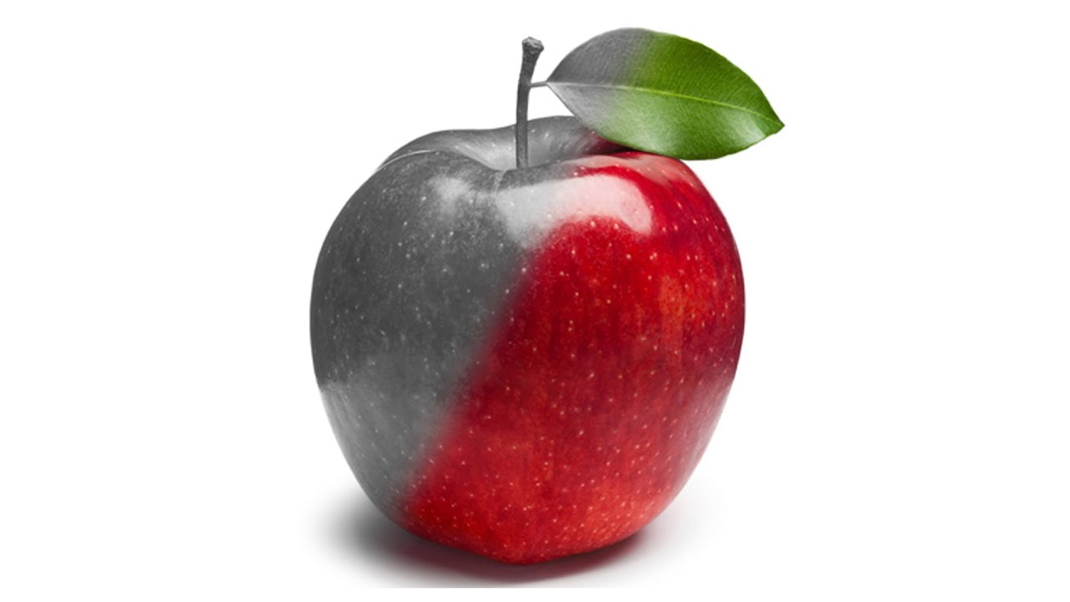
Wednesday February 12, 2020 8th Grade ELA
The Giver
Check Chapter 2
Read Chapter 3
Writing Prompt #3 - Complaints
Vocabulary 3

Slide 4
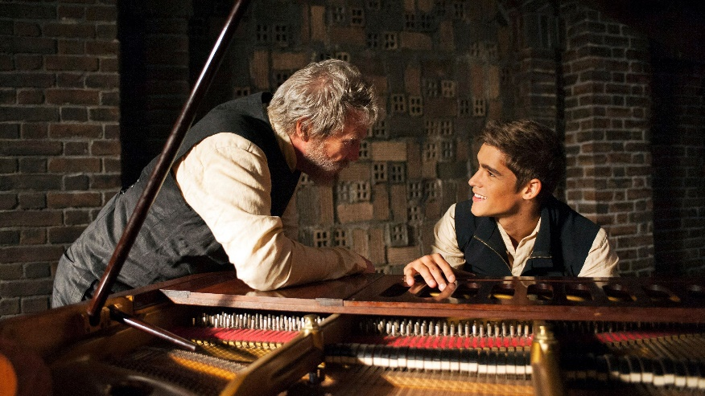
Thursday February 13, 2020 8th Grade ELA
The Giver
Check Chapter 3
Read Chapter 4 and Discussion Questions
Writing Prompt #4 - Colors

