Slide 1
Monday February 10, 2020 7th Grade ELA
IDR – Task Sheet
Finish Ambush
Informational Essay
Finish Typing
Figurative Language
Similes and Metaphors Practice

Slide 2
Tuesday February 11, 2020 7th Grade ELA
IDR – Task Sheet
Golpe de Estado
Vocabulary
Figurative Language
Check Alliteration
Hyperbole Practice

Slide 3
Wednesday February 12, 2020 7th Grade ELA
IDR – Task Sheet
Golpe de Estado Read Aloud
Figurative Language Packet

Slide 4
Thursday February 13, 2020 7th Grade ELA
IDR – Task Sheet
Golpe de Estado
Reading Guide
Figurative Language
Color Coding Handout

Slide 5
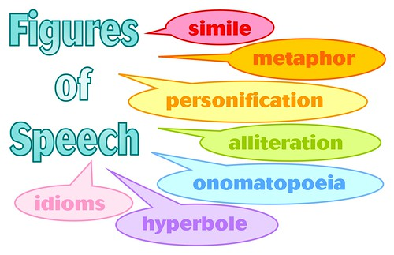
Friday February 14, 2020 7th Grade ELA
IDR – Task Sheet
Golpe de Estado
Discussion Questions
Figurative Language Practice

