Slide 1
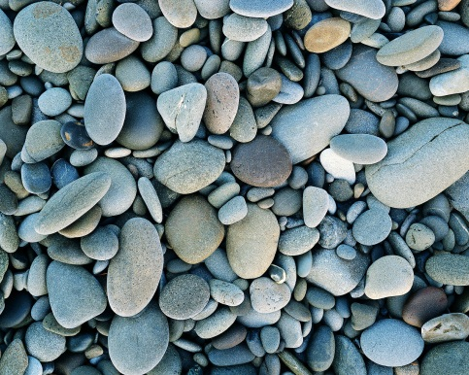
Activity 17: The Minerals in Rocks
White Space ?:
What do you think a rock is made of? Make a prediction.
Challenge Question:
Can you identify one of the minerals found in a rock?
Background: Read the introduction on page b25 and write down 1 fact.
Vocabulary:
Property: Characteristics of a material or object.
Streak Color: The color of powder a particular rock has when scratched on a ceramic plate.

Slide 2
Activity 17: The Minerals in Rocks
Materials: Read over the list on p B-26
Procedure: Read p B-27 and check off if you understand
Data: Record data on student sheet 17.1 Rock Observations

Slide 3
Activity 17: The Minerals in Rocks
Analysis Questions: On page B-28 answer questions #1-4
Conclusion: What are rocks made up of? What mineral is in limestone? Use evidence from the activity in order to support your decision.
Notes to Self: Finish for Homework!

